Slide 1
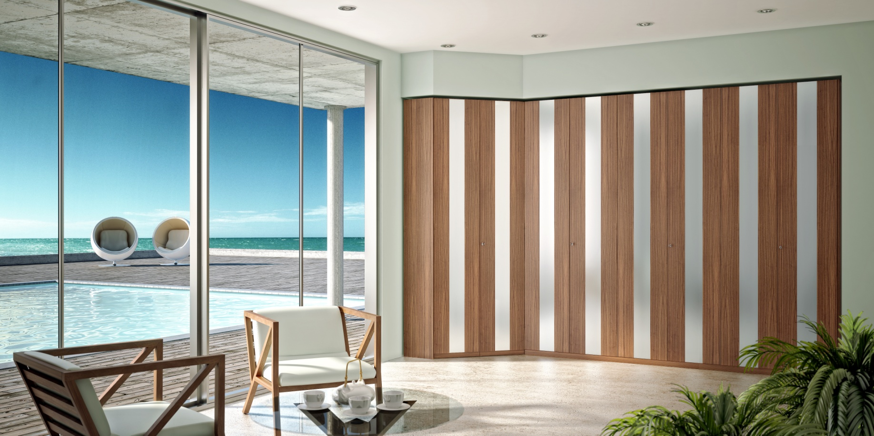
Multilayer WPC-Extrusion
Advantages and Cost Reduction
Markku Vilkki CEO Conenor Ltd

Slide 2
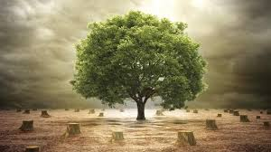
WE HAVE TO LEARN HOW TO RECYCLE AND USE WASTE AND SIDE STREAMS AS RAW MATERIALS TWO OR BETTER THREE TIMES AND;
START DOING IT !
August 19

Slide 3
Wood based composites are materials that have many many positive aspects and global volumes are growing every year -
but yet used only marginally …why ?
Is it because of their perfomance … NO !
Is it because they are not standardized …
partly yes ! ..but still that is not the main reason
It is because they are too expensive !!

Slide 4
What do we consider (too) expensive ?
If/As treated wood planks retail price/m2 is 100 and WPC is ~300 as it is today in Finland – it is too expensive for most DIY home owners !
Does WPC need to be/come that expensive …NO !
A) WPC decking planks’ price FOB Shanghai ~110
B) In FIN made WPC cost comes ~75% from raw
materials which is the key for cost reduction

Slide 5
Raw material costs in WPCs (in ranking order)
1. Virgin plastics (PE,PP) +/-1,5 Eur/kg
2. Additives (color, UV, processing aid, coupling agent, etc.) from 4 to 20 Eur/kg
3. Fibres (anything from 0 to 0,5 Eur/kg)
4. Fillers & Minerals (from 0,3 to 1 Eur/kg)
…therefore to save in materials ;
Do not use virgin plastics nor expensive additives other than where absolutely necessary
Go for high fibre/filler contents of low prices

Slide 6
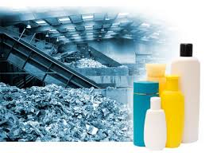
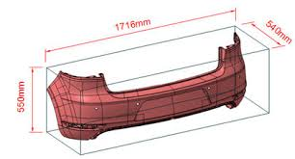
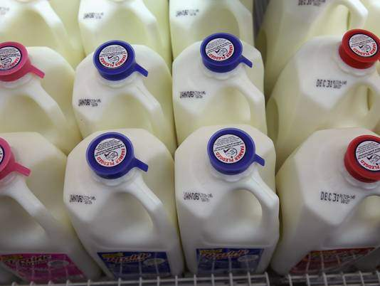
Recycled plastics – what and from where ?
Manufacturing (ex-factory) waste and side streams
consistent quality, not aged, not contaminated
rigid grades crushed but not pelletized from 0,6 Eur/kg
Consumer waste more problematic
needs separation and cleaning, aged, contaminated
can be crush or pelletized from (FIN) 0,8 Eur/kg up
some sources are good – some are not …reliability key !

Slide 7
However…using recyled plastics on product surface and deleting additives gives issues ;
Aesthetics not as wanted
Weathering causes changes; color fading, crumbling etc
Original strenght values not as required and get worse
Processing deficiences and loss of production due poor product surface (cracking, tearing, etc.)
It is necessary to use known right plastic grade and quality as well as additives at surface layer mostly contributing to product and processing performance !

Slide 8
Thus we have to think MULTILAYERS..
when building properties to make WPCs attractive to buyers and specifiers;
→use right plastics and additives at surface layer
B. when making WPCs affordable and/or competitive to buyers;
→ use waste/side streams/recycled plastics at core layer embeddded by the surface layer

Slide 9
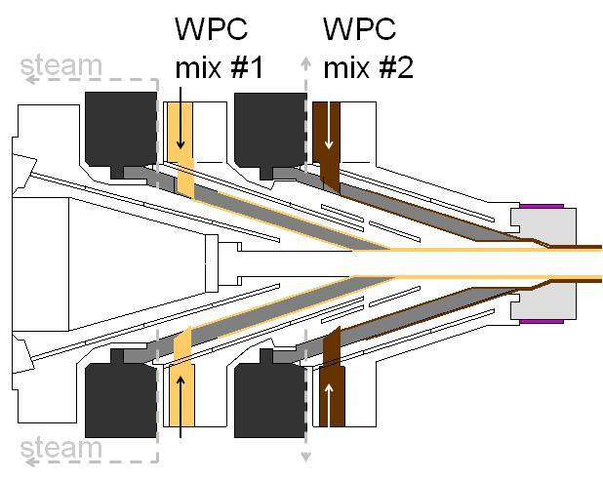
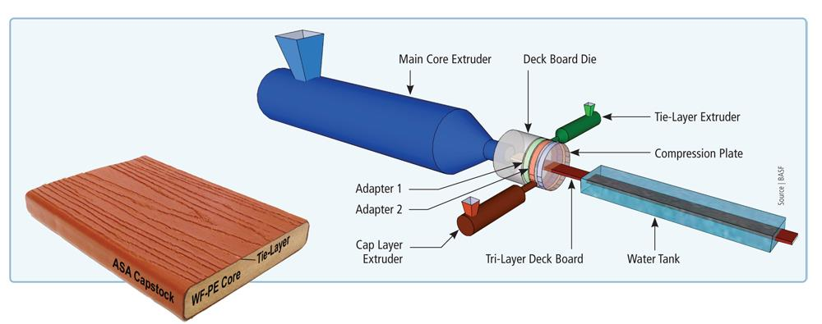
Multilayer WPC-Extrusion
Methods
Capping WPC-core with plastics in co-extrusion
B. Multilayer WPCs with 2-rotor Conex®-extruder

Slide 10
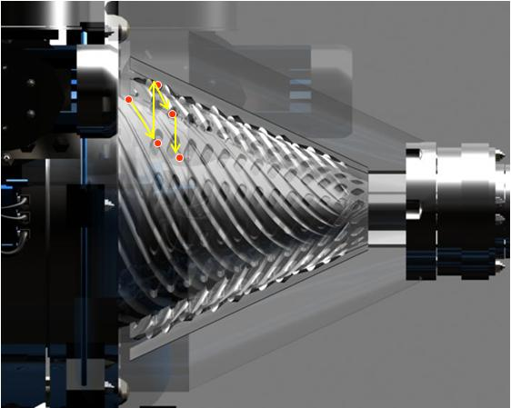
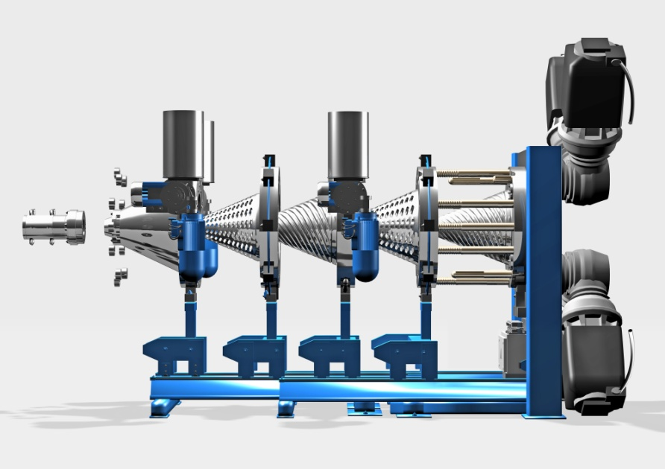
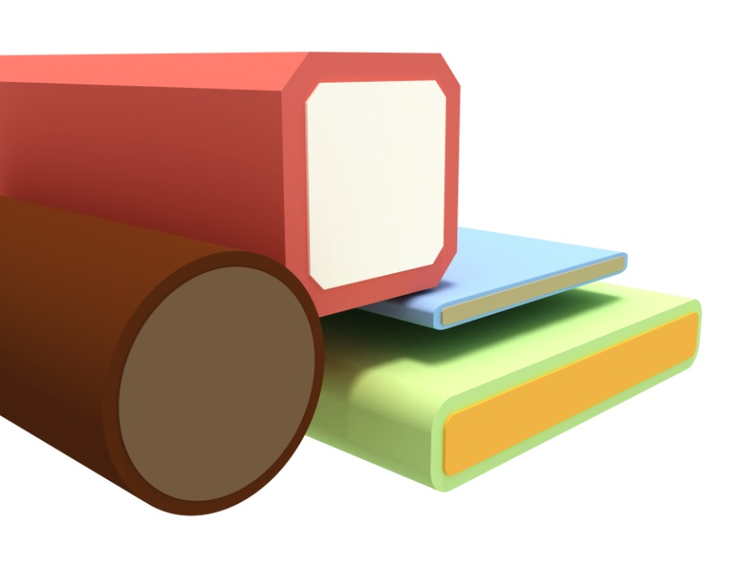
Multilayer WPC-Extrusion
Multilayer WPCs with 2-rotor Conex®-extruder

Slide 11
Animation: 2-rotor Conex®-extruder

Slide 12
Animation: Multilayer Panels with 2-rotor Conex®

Slide 13
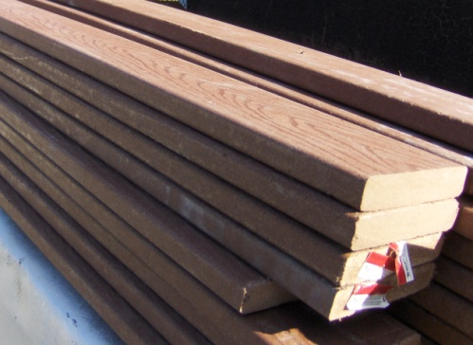
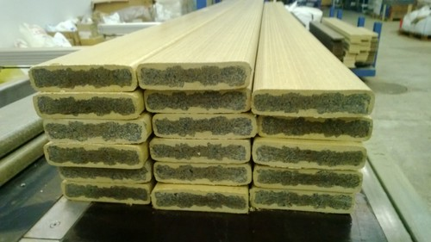
SAVINGS IN MATERIAL COSTS
Example calculation for a solid decking board 140x28mm (3,5 kg/m)
Material unit prices used in the calculation (Eur/kg) :
- fibre 0,2 - virgin plastics 1,5 - recycled plastics 0,65 - processing aid 4,5 - coupling agent 5,5 - color pigment 10 - UV-stab. 19
single layer profile 4,02 Eur/m multilayer profile 2,40 Eur/m
material cost savings 1,62 Eur/m equals -40,2%
Note; both single layer and multilayer boards have exactly the same material
formulation at board surface

Slide 14
ADVANTAGES IN MATERIAL LOGISTICS
core layer can utilize such plastics waste (mixed, hybrid, contaminated, etc.)
which are not adequate for the surface layer due aesthetics or properties
core layer can utilize various types of plastics waste available from alternative
sources and thus reducing dependency of supplies and avoid possible sudden
shortcomings
core layer gives freedom and adds flexibility in short lead times to adopt new
waste materials coming available at marginal or no cost
TAILORING PROPERTIES
high fibre content at core (up to 80%) and less at surface (ca.60%) where more
plastics is needed
simple material formulation at core with less or no expensive additives
enables to focus on tailoring the surface formulation and building on properties
cooling of product core at higher fibre content is quicker and makes it easier for
dimensional stability when less plastics is present meaning shorter lines and
higher line speeds

Slide 15
Think Wood Based
Composites in Multilayers !
Thank You !

